Slide 1
Properties of circles
Chapter 10

Slide 2
10.1 – Use Properties of Tangents
Circle
Set of all points in a plan that are equidistant from a given point called center of circle
Radius
Segment whose endpoints are center and any point on circle
Chord
Segment whose endpoints are on circle
Diameter
Chord that contains center of circle
Secant
Line that intersects circle in two points
Tangent
Line in plane of circle that intersects circle in exactly one point (called point of tangency)

Slide 3
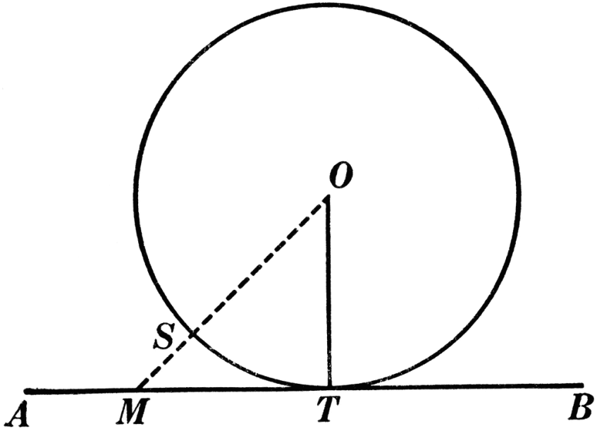
Theorem
Theorem 10.1
In a plane, a line is tangent to a circle if and only if the line is perpendicular to a radius of the circle at its endpoint on the circle

Slide 4
Examples
Example 4
In the diagram (on board) segment PT is a radius of circle P.
Is segment ST tangent to circle P?
Example 5
In the diagram (on board), B is a point of tangency.
Find the radius r, of circle C.

Slide 5
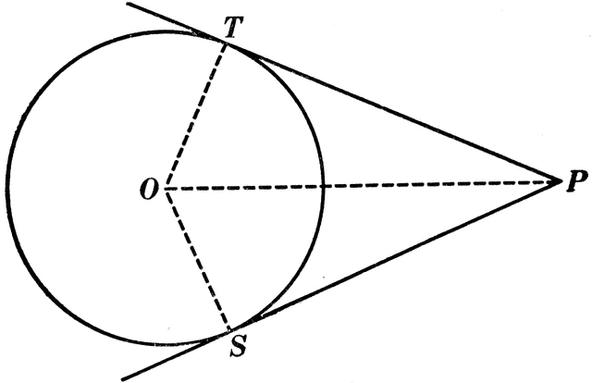
Theorem
Theorem 10.2
Tangent segments from a common external point are congruent
Example 6
Segment RS is tangent to circle C at S, and segment RT is tangent to circle C at T. Find the value of x (on board)
GP # 7-9

Slide 6
10.2 – Find Arc Measures
Central angle
Angle whose vertex is center of circle
Measure of minor arc
Determined by measure of its central angle
Measure of major arc
Determined by difference between 360° and measure of related minor arc
Semicircle arcs are 180°
Naming arcs:
Minor arcs are named by their endpoints
Major arcs and semicircles are named by their endpoints and a point on the arc

Slide 7
Adjacent Arcs
Two arcs of same circle are adjacent if they have a common endpoint
You can add measures of adjacent arcs
Postulate 23 – Arc Addition Postulate
The measure of an arc formed by two adjacent arcs is the sum of the measures of the two arcs
Example 1
Find the measure of each arc of circle P (on board), where segment RT is a diameter
A. Arc RS B.arc RTS C. arc RST

Slide 8
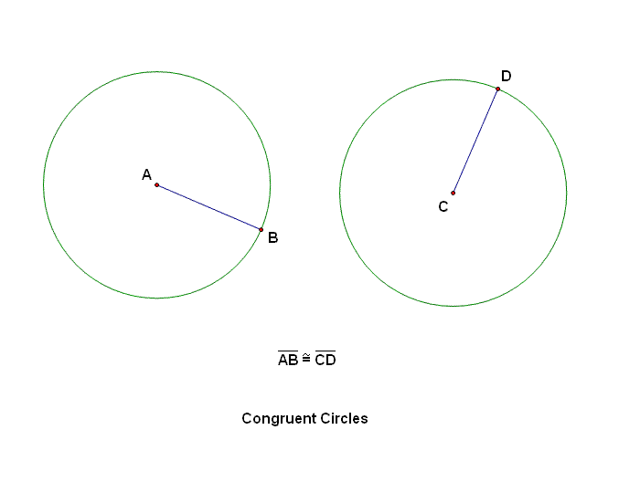
Congruent Circles and Arcs
Congruent circles
Two circles are congruent if they have same radius
Congruent arcs
Two arcs are congruent if they have same measure and they are arcs of same circle or of congruent circles

Slide 9
10.3 – Apply Properties of Chords
Recall:
Chord is segment with endpoints on circle
Any chord divides circle into two arcs
Diameter divides circle into two semicircles
Any other chord divides circle into one major and one minor arc
Theorem 10.3
In the same circle, or in congruent circles, two minor arcs are congruent if and only if their corresponding chords are congruent
Example 1
In diagram (on board), $⨀P≅⨀Q, \overline{FG}≅\overline{JK}$ and arc JK = 80°
Find measure of arc FG

Slide 10
Theorems
Theorem 10.4
If one chord is a perpendicular bisector of another chord, then the first chord is a diameter
Theorem 10.5
If a diameter (radius) of a circle is perpendicular to a chord, then the diameter (radius) bisects the chord and its arc
Theorem 10.6
In the same circle, or in congruent circles, two chords are congruent if and only if they are equidistant from the center
Example 4 (on board)

Slide 11
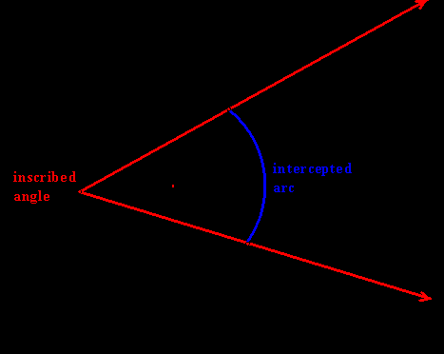
10.4 – Use Inscribed Angles & Polygons
Inscribed angle
Angle whose vertex is on circle and whose sides contain chords of circle
Intercepted arc
Arc that lies in the interior of an inscribed angle and has endpoints on angle

Slide 12
Theorems
Theorem 10.7 – Measure of an Inscribed Angle Thrm.
The measure of an inscribed angle is one half the measure of its intercepted arc
Theorem 10.8
If two inscribed angles of a circle intercept the same arc, then the angles are congruent
Example 1(on board)
Find the measure of indicated measure in circle P
Angle T
Arc QR
GP #1-3

Slide 13
More Theorems
Inscribed polygon
Polygon with all vertices lying on circle
Circumscribed circle
Circle that contains vertices of inscribed polygon
Theorem 10.9
If a right triangle is inscribed in a circle, then the hypotenuse is a diameter of the circle. Conversely, if one side of an inscribed triangle is a diameter of the circle, then the triangle is a right triangle and the angle opposite the diameter is the right angle
Theorem 10.10
A quadrilateral can be inscribed in a circle if and only if its opposite angles are supplementary

Slide 14
10.5 – Apply Other Angle Relationships
You know measure of an inscribed angle is half the measure of its intercepted arc
True even if one side of angle is tangent to circle
Theorem 10.11
If a tangent and a chord intersect at a point on a circle, then the measure of each angle formed is one half the measure of its intercepted arc
Example 1 (on board)

Slide 15
Intersecting Lines and Circles
If two lines intersect a circle, then there are three places where the lines can intersect each other
On the circle
Inside the circle
Outside the circle
Theorem 10.12 – Angles Inside Circle Theorem
If two chords intersect inside a circle, then the measure of each angle is one half the sum of the measures of the arcs intercepted by the angle and its vertical angle
Theorem 10.13 – Angles Outside Circle Theorem
If a tangent and a secant, two tangents, or two secants intersect outside a circle, then the measure of the angle formed is one half the difference of the measures of the intercepted arcs

Slide 16
Example 2
Find the value of x
130°
x°
156°

Slide 17
10.6 – Segment Lengths in Circles
Segments of the chord
Segments that are created when two chords intersect in the interior of a circle
Theorem 10.14 – Segments of Chords Theorems
If two chords intersect in the interior of a circle, then the product of the lengths of the segments of one chord is equal to the product of the lengths of the segments of the other chord
Example 1 (on board)

Slide 18
Tangents and Secants
Secant segment
Segment that contains a chord of a circle and has exactly one endpoint outside the circle
External segment
Part of secant segment that is outside the circle
Theorem 10.15 – Segments of Secants Theorem
If two secant segments share the same endpoint outside of a circle, then the product of the lengths of one secant segment and its external segment equals the product of the lengths of the other secant segment and its external segment
Theorem 10.16 – Segments of Secants & Tangents Thrm.
If a secant segment and a tangent segment share an endpoint outside a circle, then the product of the lengths of the secant segment and its external segment equals the square of the length of the tangent segment

Slide 19
Example 3
Use the figure to find length of RS
16
Q
R
x
S
8
T

