Slide 1
Measurement of Solids & Figures
Chapter 11

Slide 2
11.1 – Circumference & Arc Length
Circumference
Distance around circle
Theorem 11.1 – Circumference of a Circle
The circumference C of a circle is C = πd or C=2πr, where d is the diameter of the circle and r is the radius of the circle

Slide 3
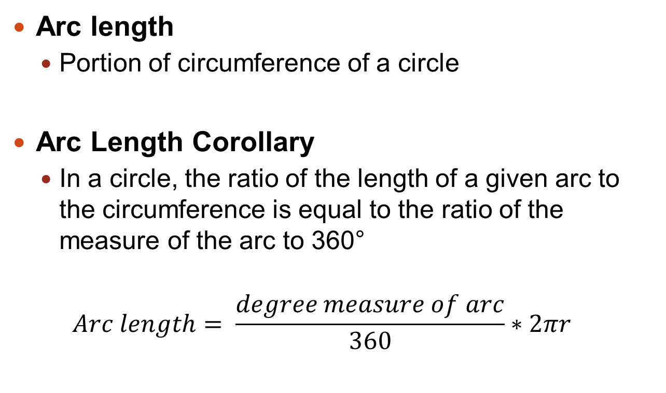
Arc Length
Arc length
Portion of circumference of a circle
Arc Length Corollary
In a circle, the ratio of the length of a given arc to the circumference is equal to the ratio of the measure of the arc to 360°
$$Arc length= \frac{degree measure of arc}{360}∗2πr$$

Slide 4
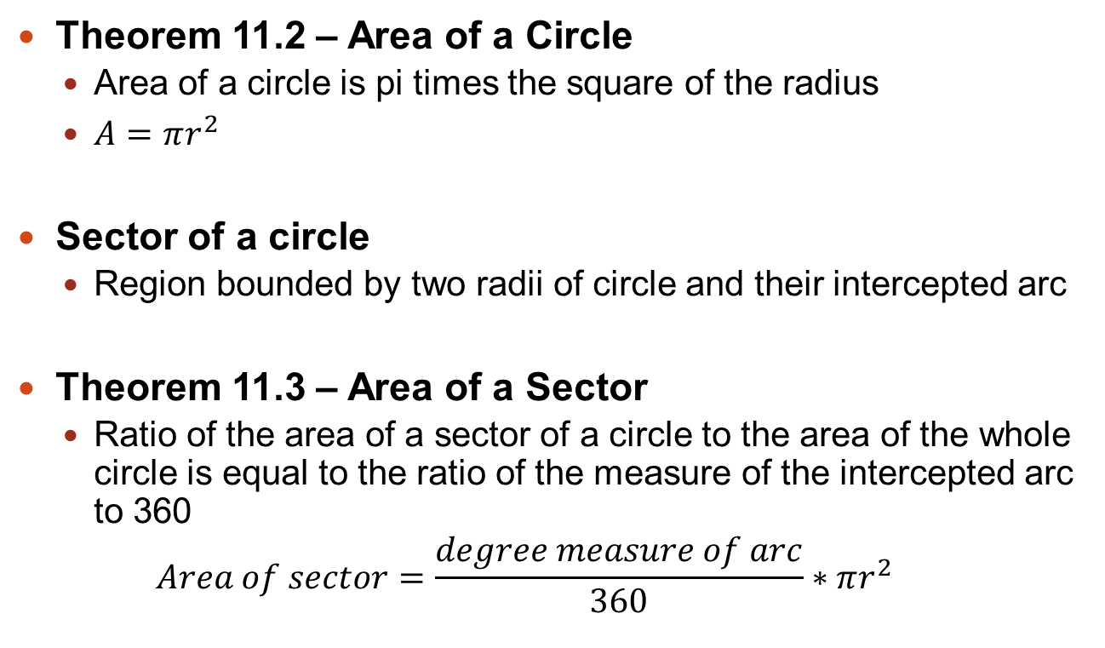
11.2 – Areas of Circles & Sectors
Theorem 11.2 – Area of a Circle
Area of a circle is pi times the square of the radius
$A=πr^{2}$
Sector of a circle
Region bounded by two radii of circle and their intercepted arc
Theorem 11.3 – Area of a Sector
Ratio of the area of a sector of a circle to the area of the whole circle is equal to the ratio of the measure of the intercepted arc to 360
$$Area of sector=\frac{degree measure of arc}{360}∗πr^{2}$$

Slide 5
11.3 – Areas of Regular Polygons
Center of polygon & radius of polygon
Center and radius of polygon’s circumscribed circle
Apothem of polygon
Distance from center to any side of polygon
Height to base of isosceles triangle that has two radii as legs
Theorem 11.4 – Area of Regular Polygon
Area of regular n-gon with side length s is one half product of apothem a and perimeter P
$$A=\frac{1}{2}aP or A=\frac{1}{2}a∗ns$$

Slide 6
11.4 – Use Geometric Probability
Geometric probability
Ratio that involves geometric measures such as length or area
Probability & Area
Let J be a region that contains region M. If a point K in J is chosen at random, then the probability that it is in region M is the ratio of the area of M to the area of J.
$$P\left(K is in region M\right)=\frac{Area of M}{Area of J}$$

Slide 7
11.5 – Explore Solids
Polyhedron
Solid that is bounded by polygons called faces that enclose a single region of space
Edge
Line segment formed by intersection of two faces
Vertex
Point where three or more edges meet

Slide 8
Types of Solids
Polyhedra
Prism
Pyramid
Non-Polyhedra
Cylinder
Cone
Sphere
To name a prism or pyramid, use shape of the base

Slide 9
Regular Polyhedra
A polyhedron is regular if all of its faces are congruent regular polygons
Platonic solids
5 regular polyhedra exist, named after Greek philosopher Plato
Regular tetrahedron (4 faces)
Cube (6 faces)
Regular Octahedron (8 faces)
Regular dodecahedron (12 faces)
Regular icosahedron (20 faces)

Slide 10
11.6 – Volume of Prisms & Cylinders
Volume
Number of cubic units contained in a solid’s interior
Postulates
Volume of a cube
The volume of a cube is the cube of the length of its side
Volume congruence
If two polyhedra are congruent, then they have the same volume
Volume addition
The volume of a solid is the sum of the volumes of all its non-overlapping parts

Slide 11
Volume Formulas
Theorem 11.6 – Volume of a Prism
$V=Bh$
Where B is the area of a base and h is the height
Theorem 11.7 – Volume of a Cylinder
$V=Bh=πr^{2}h$
Where B is the area of a base, h is the height and r is the radius of a base

Slide 12
11.7 – Volume of Pyramids & Cones
Theorem 11.9 – Volume of a Pyramid
Volume V of a pyramid is
$$V=\frac{1}{3}Bh$$
Where B is the area of the base and h is the height
Theorem 11.10 – Volume of a Cone
Volume V of a cone is
$$V=\frac{1}{3}Bh=\frac{1}{3}πr^{2}h$$
Where B is the area of the base, h is the height, and r is the radius of the base

Slide 13
11.8 – Surface Area & Volume of Spheres
Sphere
Set of all points in space equidistant from a given point called center of the sphere
Radius of a sphere is a segment from center to a point on the sphere
Chord of a sphere is a segment whose endpoints are on the sphere
Diameter of a sphere is a chord that contains the center

Slide 14
Surface Area & Volume
Theorem 11.11 – Surface Area of a Sphere
Surface area SA of a sphere is
$$SA=4πr^{2}$$
Where r is the radius of the sphere
Theorem 11.12 – Volume of a Sphere
Volume V of a sphere is
$$V=\frac{4}{3}πr^{2}$$
Where r is the radius of the sphere

