Slide 1
Reasoning & Proof
Chapter 2

Slide 2
2.1 – Use Inductive Reasoning
Geometry was developed partly by people recognizing and describing patterns
Example 1
  Page 64
Example 2
  Describe pattern in the numbers -7, -21, -63, -189, … and write the next three numbers in the pattern

Slide 3
Inductive Reasoning
Conjecture
  Unproven statement that is based on observations
Inductive reasoning
  Process that involves looking for patterns and making conjectures
Example 3
  Given five collinear points, make a conjecture about the number of ways to connect different pairs of the points

Slide 4
Disproving Conjectures
To show a conjecture is true, you must show it is true for all cases
Counterexample
  Specific case for which the conjecture is false
Example 5
  A student makes the following conjecture about the sum of two numbers. Find a counterexample to disprove the student’s conjecture
  Conjecture: The sum of two numbers is always greater than the larger number.

Slide 5
2.2 – Analyze Conditional Statements
Conditional statement
  Logical statement that has two parts, hypothesis and conclusion
Hypothesis
  “if” part of conditional statement
Conclusion
  “then” part of conditional statement
“If it is raining, then there are clouds in the sky.”

Slide 6
Writing Conditional Statements
Example 1
  Rewrite the following conditional statements in if-then form
All birds have feathers
Two angles are supplementary if they are a linear pair
Solutions
  If an animal is a bird, then it has feathers.
  If two angles are a linear pair, then they are supplementary.

Slide 7
Negation
Negation
  Opposite of original statement (negative of statement)
Statement 1 Negation of Statement 1
  The ball is red The ball is NOT red
Statement 2 Negation of Statement 2
  The cat is not black The cat is black

Slide 8
Verifying Statements
Statements can be true or false
To show a conditional statement is true, you must prove the conclusion is true every time the hypothesis is true
To show a conditional statement is false, you only need to show ONE counterexample

Slide 9
Related Conditionals
Converse
  Hypothesis and conclusion of if-then form of statement are exchanged
Inverse
  Hypothesis and conclusion of if-then form of statement are negated
Contrapositive
  Hypothesis and conclusion of if-then form of statement are exchanged AND negated

Slide 10
Equivalent Statements
Equivalent statements
  Two statements that are both true or both false
A definition can be written as a conditional statement in both if-then form and its converse
  Both the if-then form and its converse will be TRUE statements for definitions
Biconditional statements
  When both conditional statement and its converse are true, they can be written as a single statement
  Any valid definition can be written as biconditional statement
  Uses the terms “if and only if”

Slide 11
Example 4
Write the definition of perpendicular lines as a biconditional statement
Definition/Conditional statement
  If two lines intersect to form a right angle, then they are perpendicular
Converse statement
  If two lines are perpendicular, then they intersect to form a right angle
Biconditional statement
  Two lines are perpendicular if and only if they intersect to form a right angle

Slide 12
2.3 – Apply Deductive Reasoning
Deductive reasoning
  Using facts, definitions, accepted properties, and laws of logic to form a logical argument
LAWS OF LOGIC
Law of Detachment
  If they hypothesis of a true conditional statement is true, then the conclusion is also true
Law of Syllogism
  If p, then q
  If q, then r
  If p, then r

Slide 13
Use Law of Detachment
Example 1
  Use law of detachment to make a valid conclusion in the true situation
If two segments have the same length, then they are congruent. You know that BC = XY.
Mary goes to the movies every Friday and Saturday night. Today is Friday.

Slide 14
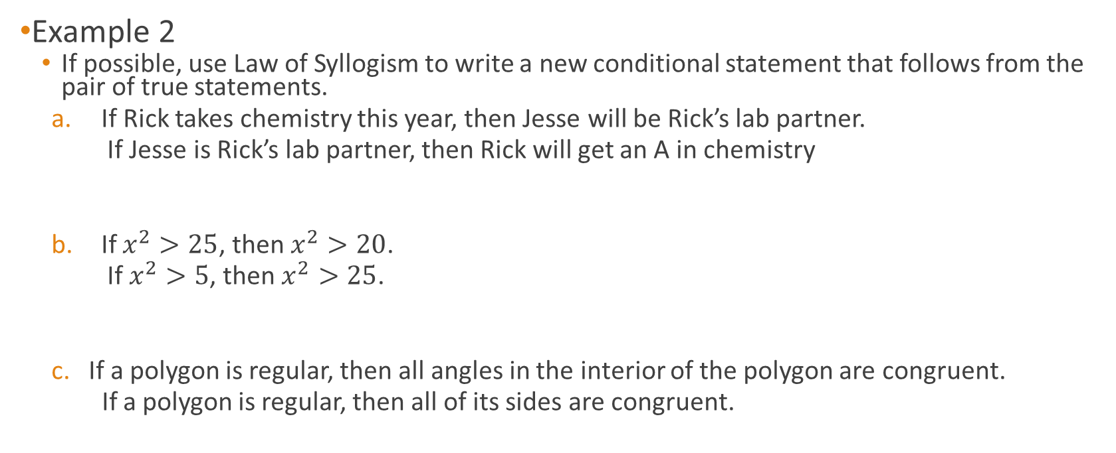
Use Law of Syllogism
Example 2
  If possible, use Law of Syllogism to write a new conditional statement that follows from the pair of true statements.
  If Rick takes chemistry this year, then Jesse will be Rick’s lab partner.
  If Jesse is Rick’s lab partner, then Rick will get an A in chemistry
  If $x^{2}>25$, then $x^{2}>20$.
  If $x^{2}>5$, then $x^{2}>25$.
  If a polygon is regular, then all angles in the interior of the polygon are congruent.
  If a polygon is regular, then all of its sides are congruent.

Slide 15
Analyzing Reasoning
In Geometry, inductive reasoning will frequently be used to make conjectures
Deductive reasoning will be used to show conjectures are true or false
Example 4 – decide which type of reasoning is being used to reach the conclusion
  Each time Monica kicks a ball up in the air, it returns to the ground. So the next time Monica kicks a ball, it will return to the ground.
  All reptiles are cold blooded. Parrots are not cold blooded. Sue’s pet parrot is not a reptile.

Slide 16
2.4 – Use Postulates & Diagrams
Recall that postulates/axioms are rules that are accepted without proof
  Rules that need to be proved are called theorems
  Unlike converse of definitions, converses of a postulate or theorem cannot be assumed to be true
Point, Line, & Plane Postulates
  5. Through any two points there exists exactly one line
  6. A line contains at least two points
  7. If two lines intersect, then their intersection is exactly one point
  8. Through any three noncollinear points there exists exactly one plane
  9. A plane contains at least three noncollinear points
  10. If two points lie in a plane, then the line containing them lies in the plane
  11. If two planes intersect, then their intersection is a line

Slide 17
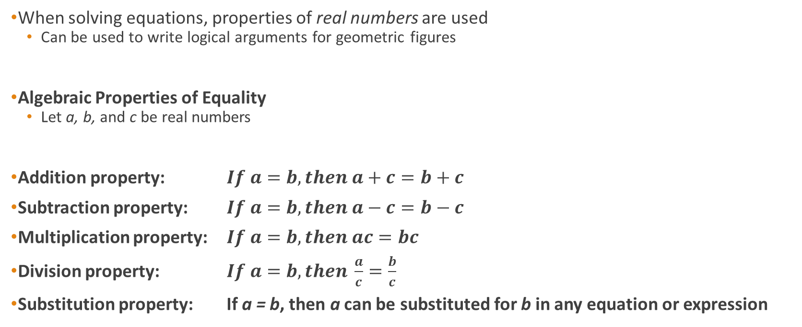
2.5 – Reason Using Properties from Algebra
When solving equations, properties of real numbers are used
  Can be used to write logical arguments for geometric figures
Algebraic Properties of Equality
  Let a, b, and c be real numbers
Addition property: $If a=b, then a+c=b+c$
Subtraction property: $If a=b,then a−c=b−c$
Multiplication property: $If a=b, then ac=bc$
Division property: $If a=b, then \frac{a}{c}=\frac{b}{c}$
Substitution property: If a = b, then a can be substituted for b in any equation or expression

Slide 18
Example 1
Solve 2x + 5 = 20 – 3x. Write a reason for each step.
Equation Explanation Reason
2x + 5 = 20 – 3x Write original equation Given

Slide 19

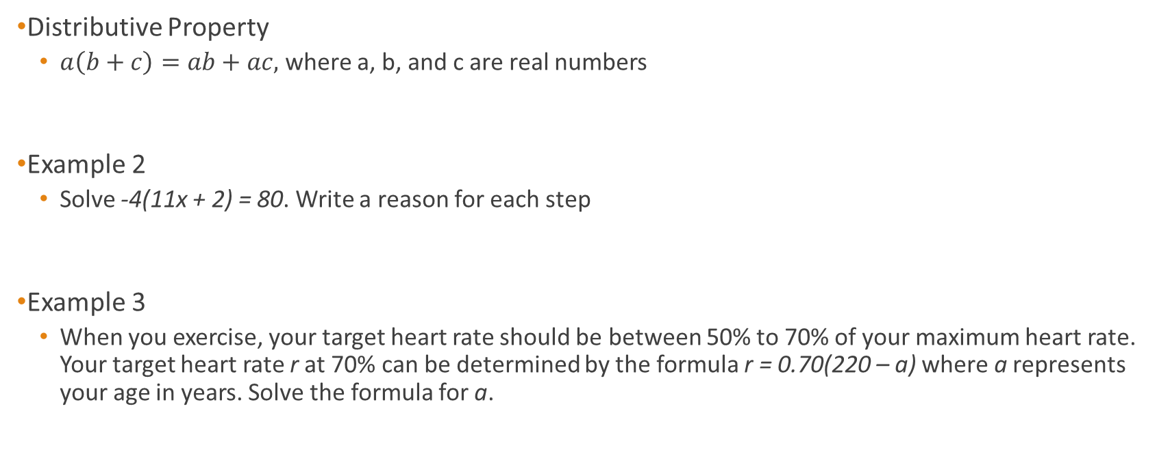
Distributive Property
Distributive Property
  $a\left(b+c\right)=ab+ac,$ where a, b, and c are real numbers
Example 2
  Solve -4(11x + 2) = 80. Write a reason for each step
Example 3
  When you exercise, your target heart rate should be between 50% to 70% of your maximum heart rate. Your target heart rate r at 70% can be determined by the formula r = 0.70(220 – a) where a represents your age in years. Solve the formula for a.

Slide 20
Reflexive, Symmetric, Transitive Props.
Reflexive Property
Numbers: a = a
Segment: AB = AB
Angle: m<A = m<A
Symmetric Property
Numbers: If a = b, then b = a
Segments: If AB = CD, then CD = AB
Angles: If m<A = m<B, then m<B = m<A
Transitive Property
Numbers: If a = b and b = c, then a = c
Segments: If AB = CD and CD = EF, then AB = EF
Angles: If m<A = m<B and m<B = m<C, then m<A = m<C

Slide 21

Examples
Example 4
  You are designing a logo to sell daffodils. Use the information given. (page 99)
  Determine whether $m∠EBA=m∠DBC$
Example 5
  In the diagram (page 100) AB = CD, show that AC = BD

Slide 22
2.6 – Prove Statement about Segments and Angles
Proof
  Logical argument that shows a statement is true
Two-column proof
  Format for proof that has numbered statements and corresponding reasons that show an argument in logical order
Example 1
  Write two-column proof for situation in example 4, lesson 2.5 (Daffodil logo)

Slide 23
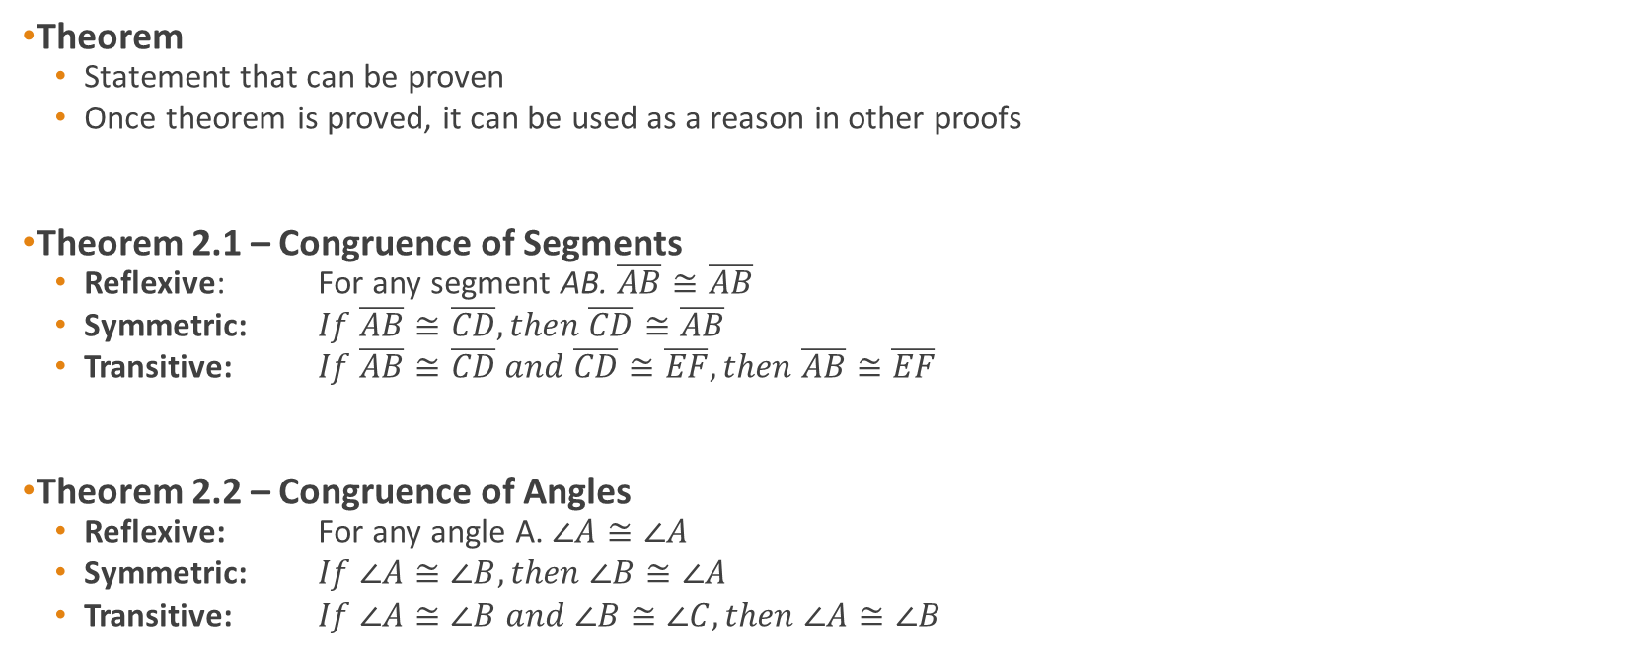
Theorems
Theorem
  Statement that can be proven
  Once theorem is proved, it can be used as a reason in other proofs
Theorem 2.1 – Congruence of Segments
  Reflexive: For any segment AB. $\overline{AB}≅\overline{AB}$
  Symmetric: $If \overline{AB}≅\overline{CD}, then \overline{CD}≅\overline{AB}$
  Transitive: $If \overline{AB}≅\overline{CD} and \overline{CD}≅\overline{EF}, then \overline{AB}≅\overline{EF}$
Theorem 2.2 – Congruence of Angles
  Reflexive: For any angle A. $∠A≅∠A$
  Symmetric: $If ∠A≅∠B, then ∠B≅∠A$
  Transitive: $If ∠A≅∠B and ∠B≅∠C, then ∠A≅∠B$

Slide 24
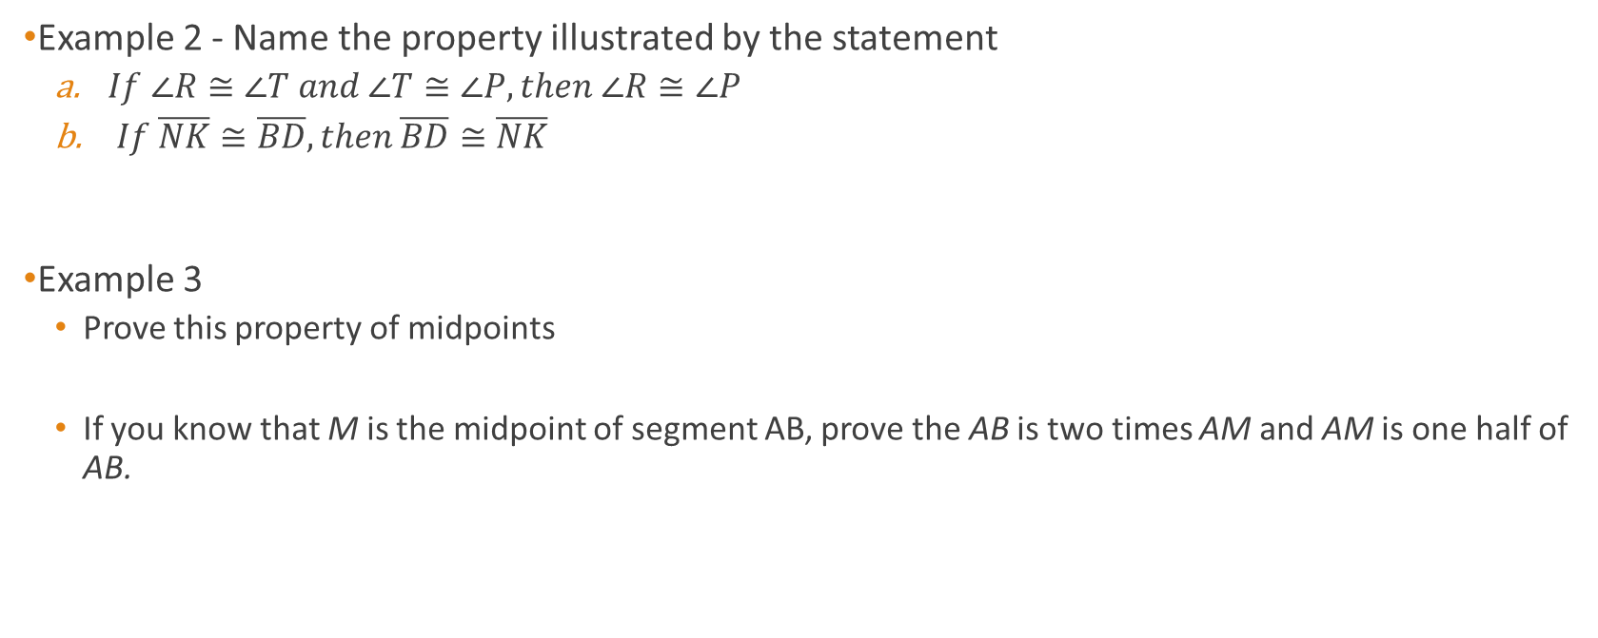
Examples
Example 2 - Name the property illustrated by the statement
  $If ∠R≅∠T and ∠T≅∠P, then ∠R≅∠P$
  $If \overline{NK}≅\overline{BD}, then \overline{BD}≅\overline{NK}$
Example 3
  Prove this property of midpoints
  If you know that M is the midpoint of segment AB, prove the AB is two times AM and AM is one half of AB.

Slide 25
Example 4
Walking down a hallway at the mall, you notice the music store is halfway between the food court and the shoe store. The shoe store is halfway between the music store and the book store. Prove that the distance between the entrances of the food court and music store is the same as the distance between the entrances of the shoe store and bookstore.

Slide 26
2.7 – Prove Angle Pair Relationships
Sometimes a new theorem describes a relationship that is useful in writing proofs
Theorem 2.3 – Right Angles Congruence Theorem
  All right angles are congruent
Example 1
  Page 116

Slide 27
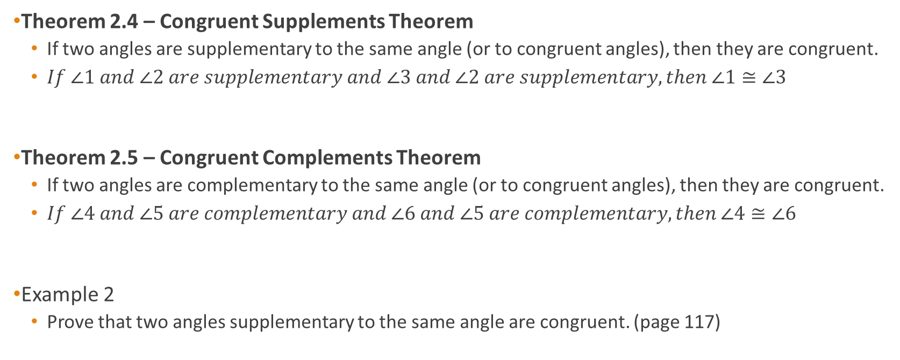
Supplements & Complements
Theorem 2.4 – Congruent Supplements Theorem
  If two angles are supplementary to the same angle (or to congruent angles), then they are congruent.
  $If ∠1 and ∠2 are supplementary and ∠3 and ∠2 are supplementary, then ∠1≅∠3$
Theorem 2.5 – Congruent Complements Theorem
  If two angles are complementary to the same angle (or to congruent angles), then they are congruent.
  $If ∠4 and ∠5 are complementary and ∠6 and ∠5 are complementary, then ∠4≅∠6$
Example 2
  Prove that two angles supplementary to the same angle are congruent. (page 117)

Slide 28
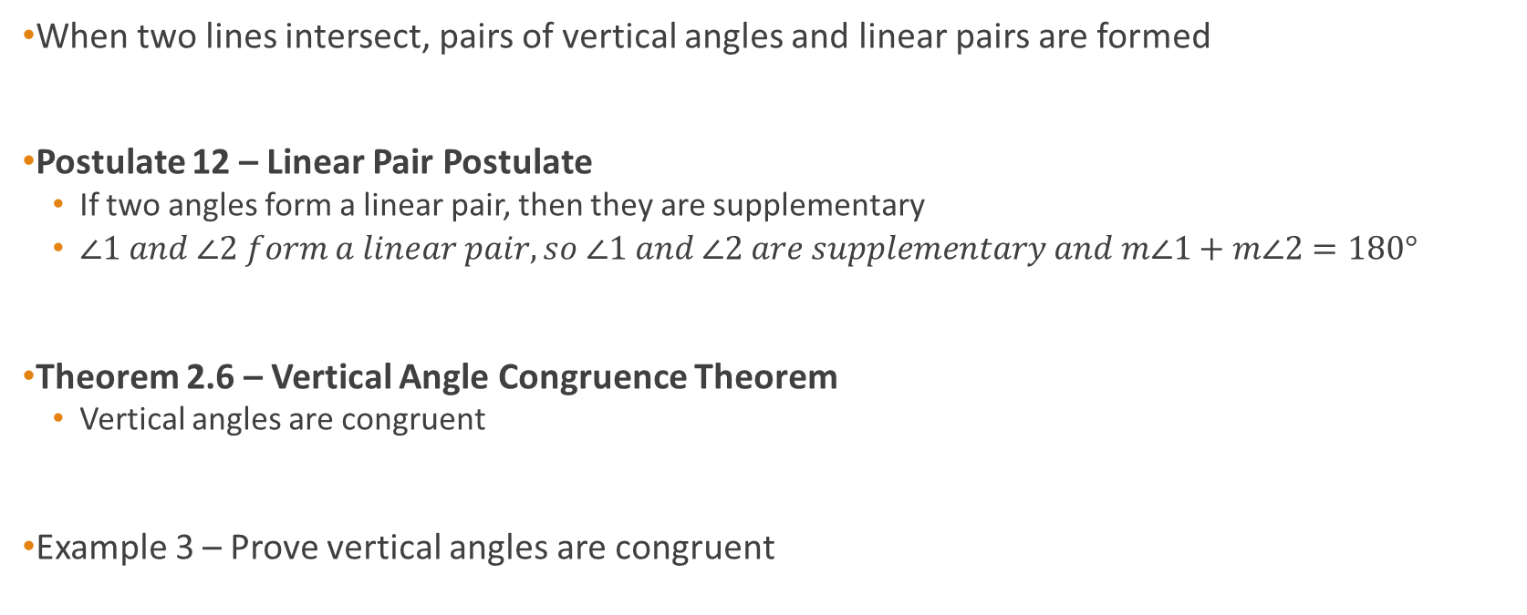
Intersecting Lines
When two lines intersect, pairs of vertical angles and linear pairs are formed
Postulate 12 – Linear Pair Postulate
  If two angles form a linear pair, then they are supplementary
  $∠1 and ∠2 form a linear pair, so ∠1 and ∠2 are supplementary and m∠1+m∠2=180°$
Theorem 2.6 – Vertical Angle Congruence Theorem
  Vertical angles are congruent
Example 3 – Prove vertical angles are congruent

